Slide 1
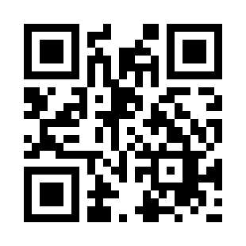


Introduction to Web Application Quiz
https://bit.ly/3D1Q3L9

